Slide 1
Perceptron Slides
Team DGMRW

Slide 2
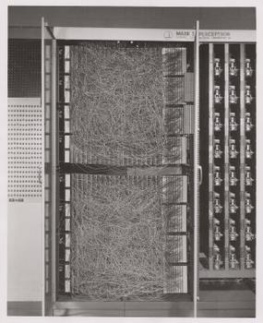
History of Perceptrons
Invented by Frank Rosenblatt in 1958 for the Navy
5 ton machine that worked on punch cards
Originally used for image recognition
Laid foundation for neural networks and AI

Slide 3
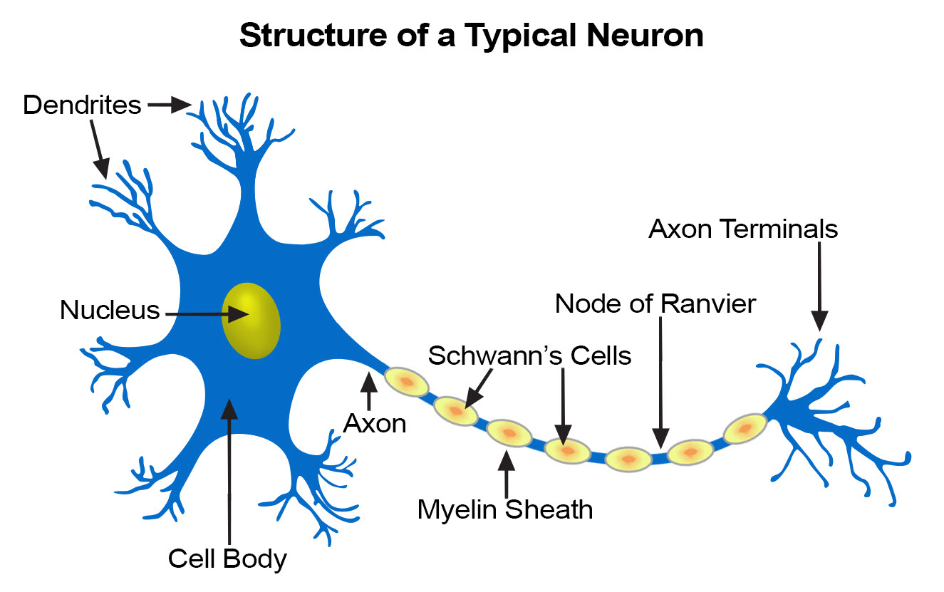
Biological Influence
Perceptron took heavy influence from neurons
Neurons fire when sum of inputs exceed some threshold
Perceptron acts like single neuron

Slide 4
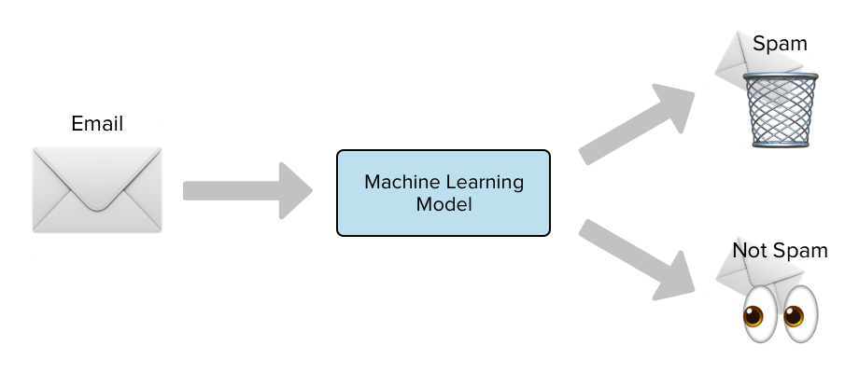
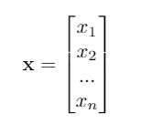
Binary Linear Classification
Binary classification assigns a set of data (input) to one of two classes
Examples: Email is spam or not, Picture is cat or dog
Perceptrons take input data (either featurized or raw data) and output predicted label
Use vector to represent input and scalar to represent output
For classifying emails as spam or not, 1 may represent an email that is spam while 0 represents an email that is not (encoding)

Slide 5
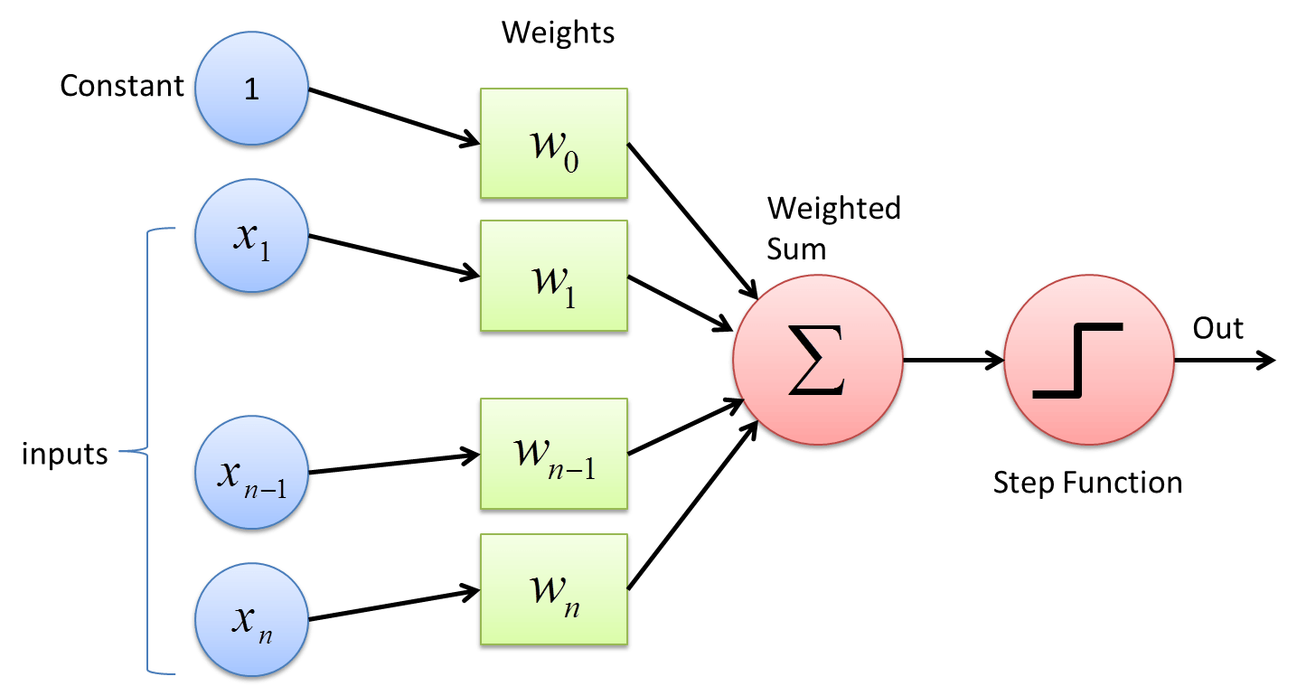
What are Perceptrons?
Building blocks of neural networks
Used primarily for binary linear classification
Weighted sum of inputs + Step Function
Finds dividing hyperplane to separate data

Slide 6
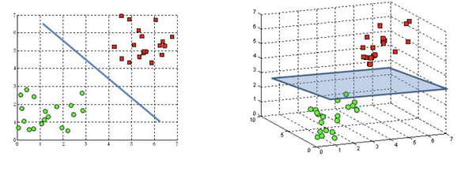
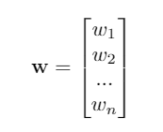
Weights
One weight for each input
“Training” the perceptron is finding the optimal weights for a given data set
Weight vector represents separating hyperplane of data
Dot product of weight vector and input is positive for one class or negative for the other

Slide 7
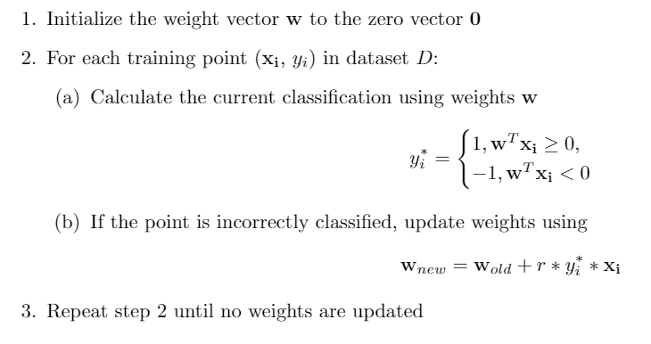
Perceptron Learning Algorithm

Slide 8
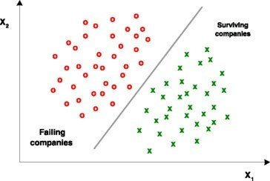
Perceptron Learning Algorithm (cont.)
Iterative algorithm for finding weights
“r” represents learning rate, can be tuned
Only update weights if incorrect
Perceptrons will only work if data is linearly separable
Linear separability guarantees convergence
Learning Algorithm does not have to find optimal weights
Runtime of Learning

Slide 9
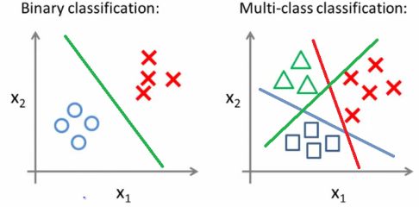

Multiclass Classification
Perceptron algorithm only works for binary case
For multiclass classification, slightly modify perceptron
One weight vector for every class
New classification rule:

Slide 10
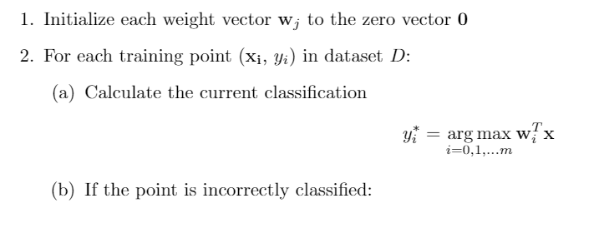
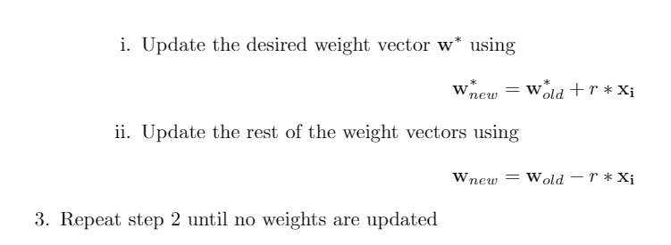
Multiclass Classification (cont.)
Modified weight update algorithm
Still only update weights if incorrect
Add to correct weight vector
Subtract from others (incorrect weights)
Hope that argmax correctly classifies next time

Slide 11
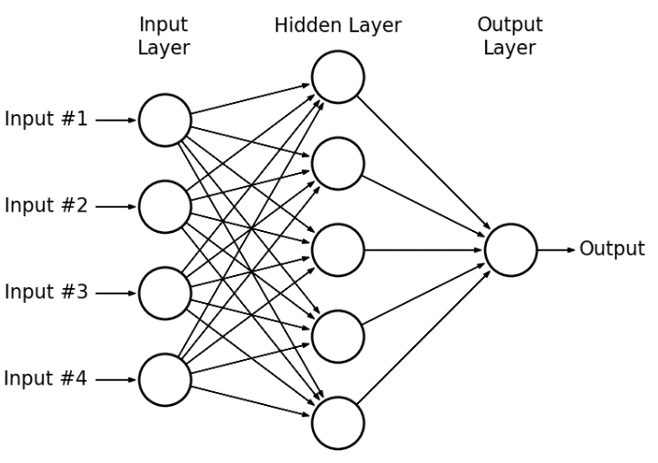
Beyond Perceptrons
Linear separability assumption severely limits uses for perceptrons
Can chain multiple perceptrons together to avoid this
Called Multilayer Perceptron
Perceptron doesn’t find optimal weights
Adding data points can shift hyperplane
Outliers

